Slide 1

Network Traffic Monitoring Using Wireshark

Slide 2
Motivation for Network Monitoring
Essential for Network Management
Router and Firewall policy
Detecting abnormal/error in networking
Access control
Security Management
Detecting abnormal traffic
Traffic log for future forensic analysis

Slide 3
Tools Overview
Tcpdump
Unix-based command-line tool used to intercept packets
Including filtering to just the packets of interest
Reads “live traffic” from interface specified using -i option …
… or from a previously recorded trace file specified using -r option
You create these when capturing live traffic using -w option
Tshark
Tcpdump-like capture program that comes w/ Wireshark
Very similar behavior & flags to tcpdump
Wireshark
GUI for displaying tcpdump/tshark packet traces

Slide 4
Tcpdump example
Ran tcpdump on a Unix machine
First few lines of the output:
01:46:28.808262 IP danjo.CS.Berkeley.EDU.ssh > adsl-69-228-230-7.dsl.pltn13.pacbell.net.2481: . 2513546054:2513547434(1380) ack 1268355216 win 12816
01:46:28.808271 IP danjo.CS.Berkeley.EDU.ssh > adsl-69-228-230-7.dsl.pltn13.pacbell.net.2481: P 1380:2128(748) ack 1 win 12816
01:46:28.808276 IP danjo.CS.Berkeley.EDU.ssh > adsl-69-228-230-7.dsl.pltn13.pacbell.net.2481: . 2128:3508(1380) ack 1 win 12816
01:46:28.890021 IP adsl-69-228-230-7.dsl.pltn13.pacbell.net.2481 > danjo.CS.Berkeley.EDU.ssh: P 1:49(48) ack 1380 win 16560

Slide 5
What does a line convey?
Source port number (22)
Timestamp
This is an IP packet
Source host name
01:46:28.808262 IP danjo.CS.Berkeley.EDU.ssh >
adsl-69-228-230-7.dsl.pltn13.pacbell.net.2481: . 2513546054:2513547434(1380) ack 1268355216 win 12816
Destination host name
Destination port number
TCP specific information
Different output formats for different packet types

Slide 6
Similar Output from Tshark
1190003744.940437 61.184.241.230 -> 128.32.48.169 SSH Encrypted request packet len=48
1190003744.940916 128.32.48.169 -> 61.184.241.230 SSH Encrypted response packet len=48
1190003744.955764 61.184.241.230 -> 128.32.48.169 TCP 6943 > ssh [ACK] Seq=48 Ack=48 Win=65514 Len=0 TSV=445871583 TSER=632535493
1190003745.035678 61.184.241.230 -> 128.32.48.169 SSH Encrypted request packet len=48
1190003745.036004 128.32.48.169 -> 61.184.241.230 SSH Encrypted response packet len=48
1190003745.050970 61.184.241.230 -> 128.32.48.169 TCP 6943 > ssh [ACK] Seq=96 Ack=96 Win=65514 Len=0 TSV=445871583 TSER=632535502

Slide 7
Demo 1 – Basic Run
Syntax:
tcpdump [options] [filter expression]
Unfortunately, Eustis machine does not allow normal users to run tcpdump
$ sudo tcpdump –i eth0
Sudo command allows you to run tcpdump in root previlege
On your own Unix machine, you can run it using “sudo” or directly run “tcpdump” if you have root previliege
Observe the output
Notes:
Depending on the kind of traffic, make some general observations – sources, destinations, kinds of traffic, DNS requests etc. Too much of output.

Slide 8
Filters
We are often not interested in all packets flowing through the network
Use filters to capture only packets of interest to us

Slide 9
Demo 2
Capture only udp packets
tcpdump “udp”
Capture only tcp packets
tcpdump “tcp”

Slide 10
Demo 2 (contd.)
Capture only UDP packets with destination port 53 (DNS requests)
tcpdump “udp dst port 53”
Capture only UDP packets with source port 53 (DNS replies)
tcpdump “udp src port 53”
Capture only UDP packets with source or destination port 53 (DNS requests and replies)
tcpdump “udp port 53”

Slide 11
Demo 2 (contd.)
Capture only packets destined to longwood.eecs.ucf.edu
tcpdump “dst host longwood.eecs.ucf.edu”
Capture both DNS packets and TCP packets to/from longwood.eecs.ucf.edu
tcpdump “(tcp and host longwood.eecs.ucf.edu) or udp port 53”
Notes:
Ping quasar.cs.berkeley.edu.
Demonstrates the use of “or”

Slide 12
How to write filters
Refer the tcpdump/tshark man page
Many example webpages on the Internet

Slide 13
Running tcpdump
Requires superuser/administrator privileges on Unix
http://www.tcpdump.org/
You can do it on your own Unix machine
You can install a Linux OS in Vmware on your windows machine
Tcpdump for Windows
WinDump: http://www.winpcap.org/windump/
Free software

Slide 14

So What is WireShark?
Packet sniffer/protocol analyzer
Open Source Network Tool
Latest version of the ethereal tool

Slide 15

What is tShark?
The command-line based packet capture tool
Equivalent to Wireshark

Slide 16

Network Layered Structure
What is the Internet?
Application
Web, Email, VOIP
Application
Transport
TCP, UDP
Transport
Network
IP
Network
Data Link
Ethernet, cellular
Data Link
Physical link

Slide 17
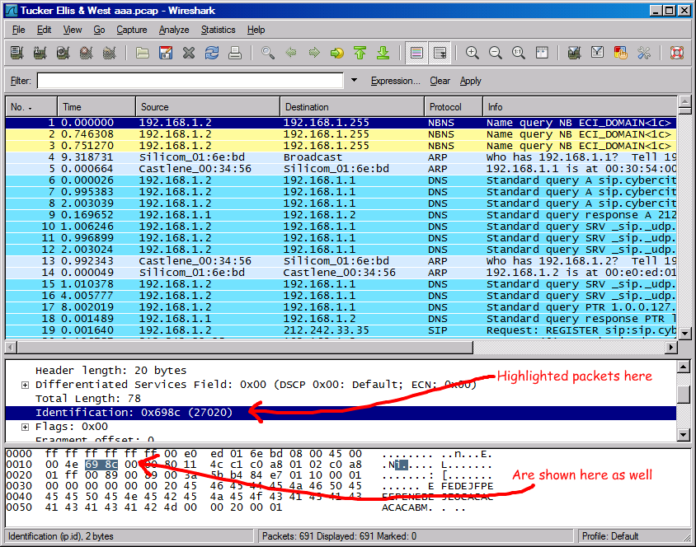
Wireshark Interface

Slide 18
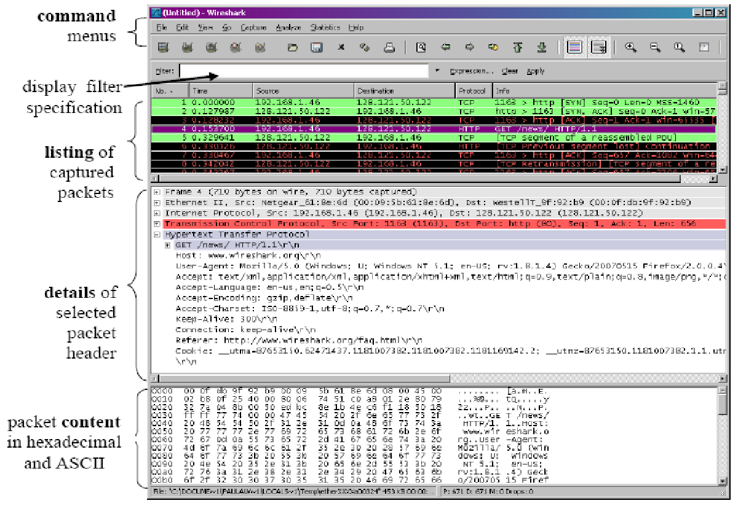
Wireshark Interface

Slide 19
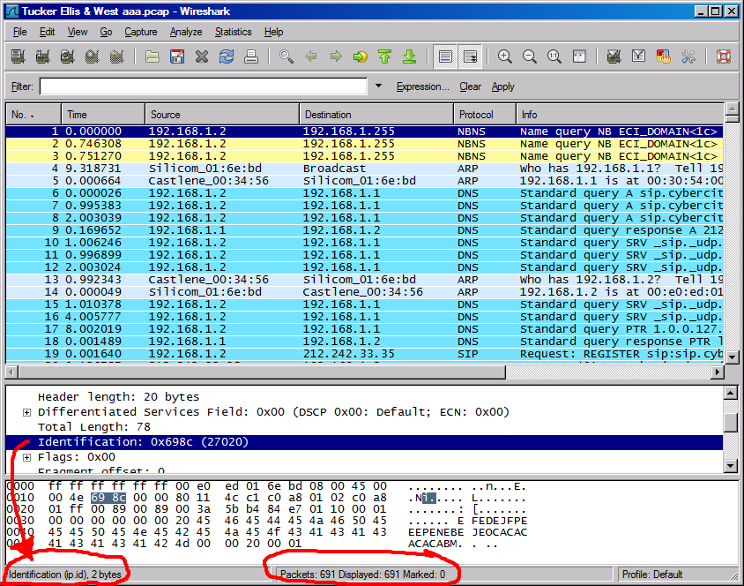
Status Bar

Slide 20
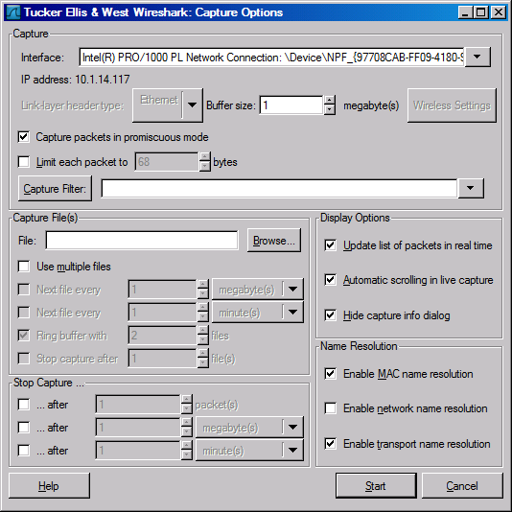
Capture Options
Promiscuous mode is used to
Capture all traffic
Sometime this does not work:
driver does not support
You are on a switch LAN

Slide 21
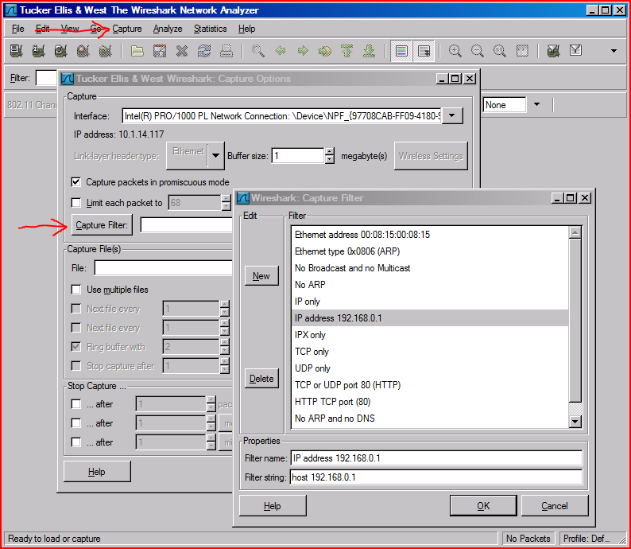
Capture Filter

Slide 22
Capture Filter examples
host 10.1.11.24
host 192.168.0.1 and host 10.1.11.1
tcp port http
ip
not broadcast not multicast
ether host 00:04:13:00:09:a3

Slide 23
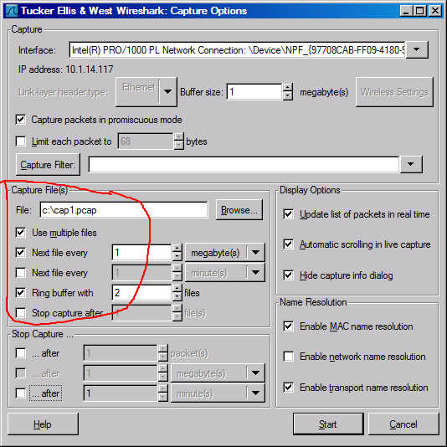

Slide 24
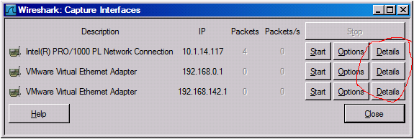
Capture Interfaces

Slide 25
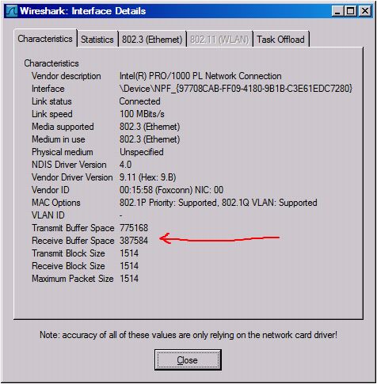
Interface Details: Characteristics

Slide 26
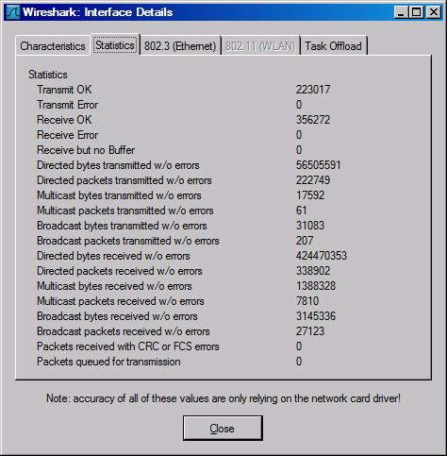
Interface Details: Statistics

Slide 27
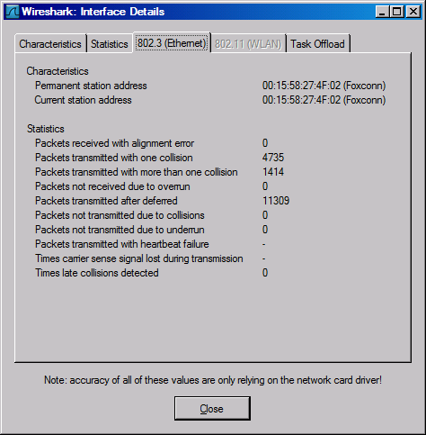
Interface Details: 802.3 (Ethernet)

Slide 28
Display Filters (Post-Filters)
Display filters (also called post-filters) only filter the view of what you are seeing. All packets in the capture still exist in the trace
Display filters use their own format and are much more powerful then capture filters

Slide 29
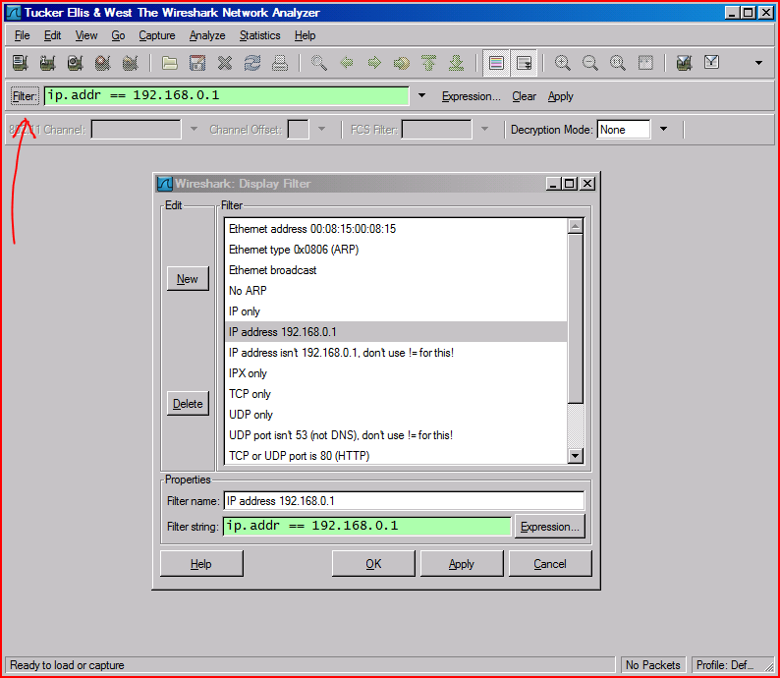
Display Filter

Slide 30
Display Filter Examples
ip.src==10.1.11.00/24
ip.addr==192.168.1.10 && ip.addr==192.168.1.20
tcp.port==80 || tcp.port==3389
!(ip.addr==192.168.1.10 && ip.addr==192.168.1.20)
(ip.addr==192.168.1.10 && ip.addr==192.168.1.20) && (tcp.port==445 || tcp.port==139)
(ip.addr==192.168.1.10 && ip.addr==192.168.1.20) && (udp.port==67 || udp.port==68)
tcp.dstport == 80

Slide 31
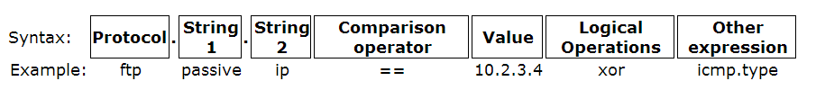
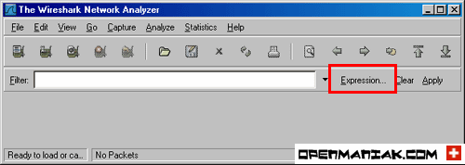
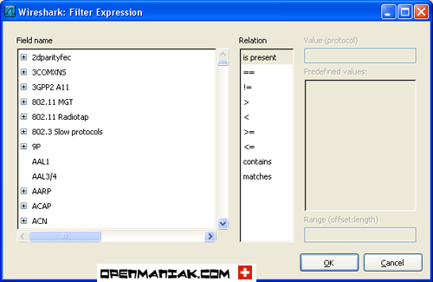
Display Filter

Slide 32
TCP segment structure
32 bits
URG: urgent data
(generally not used)
counting
by bytes
of data
(not segments!)
source port #
dest port #
sequence number
ACK: ACK #
valid
acknowledgement number
head
len
not
used
U
Receive window
A
P
R
S
F
PSH: push data now
# bytes
rcvr willing
to accept
checksum
Urg data pnter
RST, SYN, FIN:
connection estab
(setup, teardown
commands)
Options (variable length)
application
data
(variable length)
Internet
checksum
(as in UDP)

Slide 33
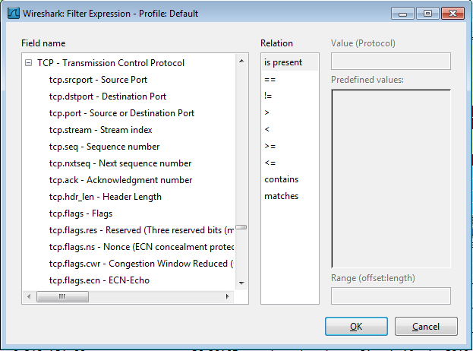

Display Filter
String1, String2 (Optional settings):
Sub protocol categories inside the protocol.
Look for a protocol and then click on the "+" character.
Example:
tcp.srcport == 80
tcp.flags == 2
SYN packet
Tcp.flags.syn==1
tcp.flags == 18
SYN/ACK
Note of TCP Flag field:

Slide 34
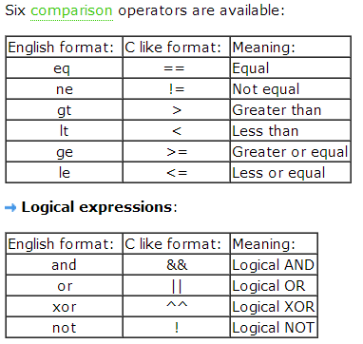
Display Filter Expressions
snmp || dns || icmp
Display the SNMP or DNS or ICMP traffics.
tcp.port == 25
Display packets with TCP source or destination port 25.
tcp.flags
Display packets having a TCP flags
tcp.flags.syn == 0x02
Display packets with a TCP SYN flag.
If the filter syntax is correct, it will be highlighted in green,
otherwise if there is a syntax mistake it will be highlighted in red.
Correct syntax
Wrong syntax

Slide 35
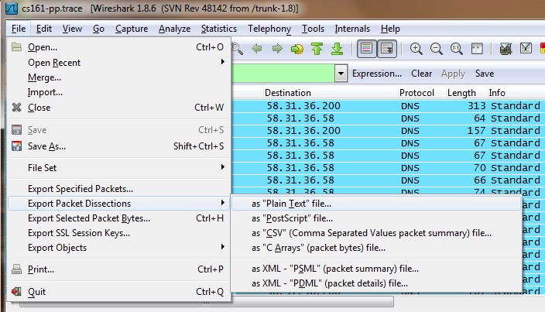
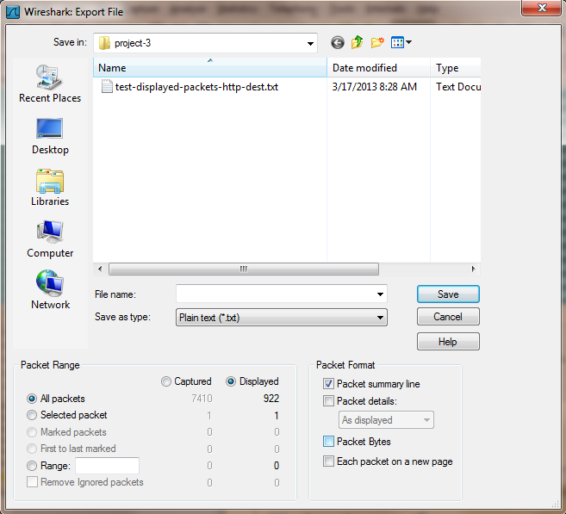
Save Filtered Packets After Using Display Filter
We can also save all filtered packets in text file for further analysis
Operation:
File🡪Export packet dissections
🡪as “plain text” file
1). In “packet range” option, select “Displayed”
2). In choose “summary line” or “detail”

Slide 36
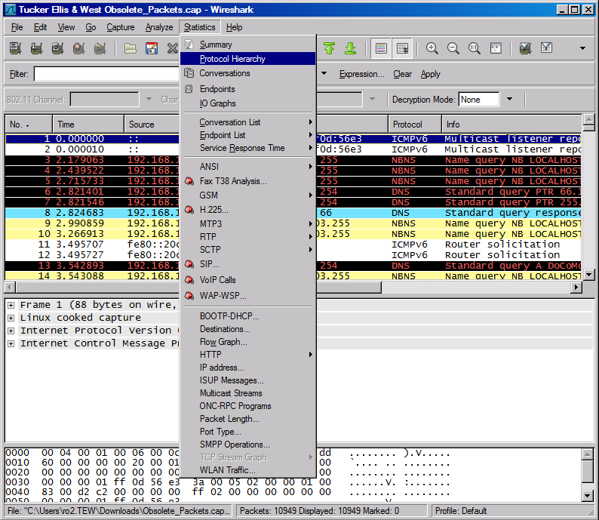
Protocol Hierarchy

Slide 37
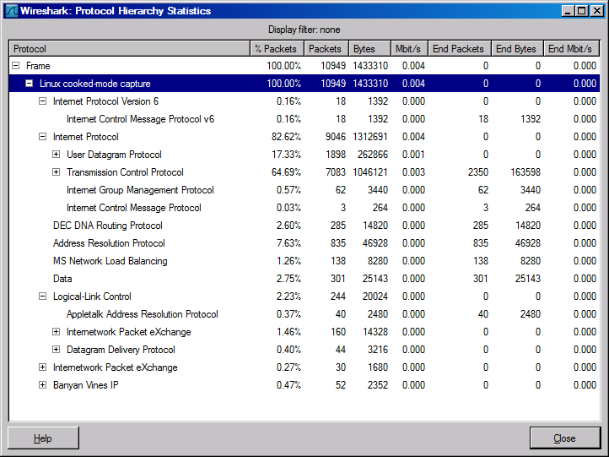
Protocol Hierarchy

Slide 38
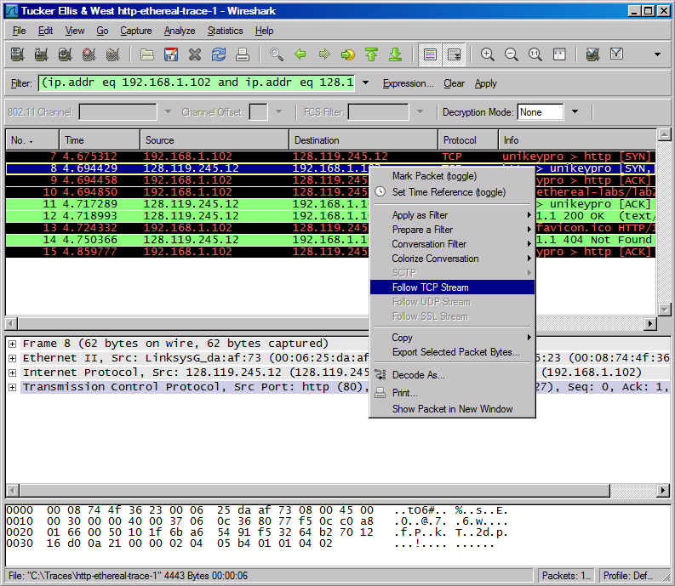
Follow TCP Stream

Slide 39
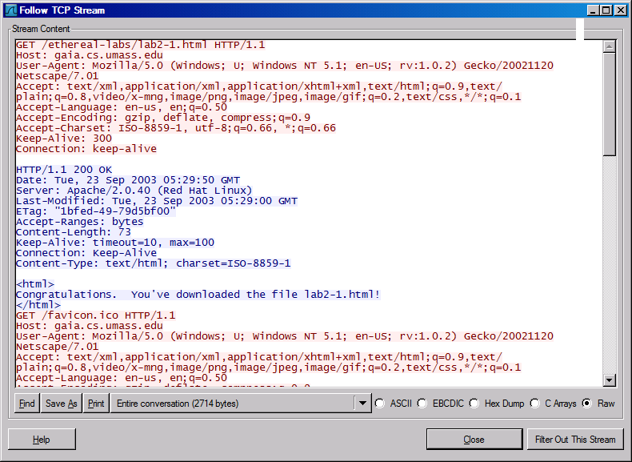
Follow TCP Stream
red - stuff you sent blue - stuff you get

Slide 40
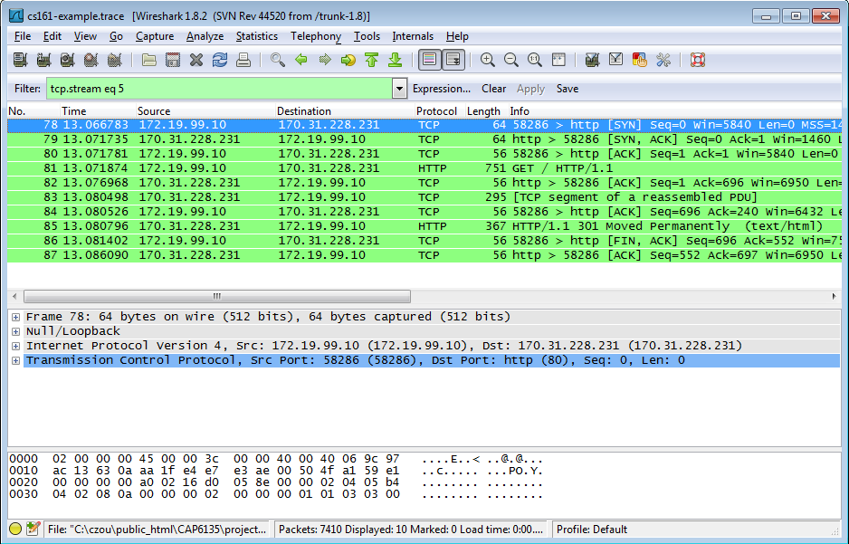
Filter out/in Single TCP Stream
When click “filter out this TCP stream” in previous page’s box, new filter string will contain like:
http and !(tcp.stream eq 5)
So, if you use “tcp.stream eq 5” as filter string, you keep this HTTP session

Slide 41
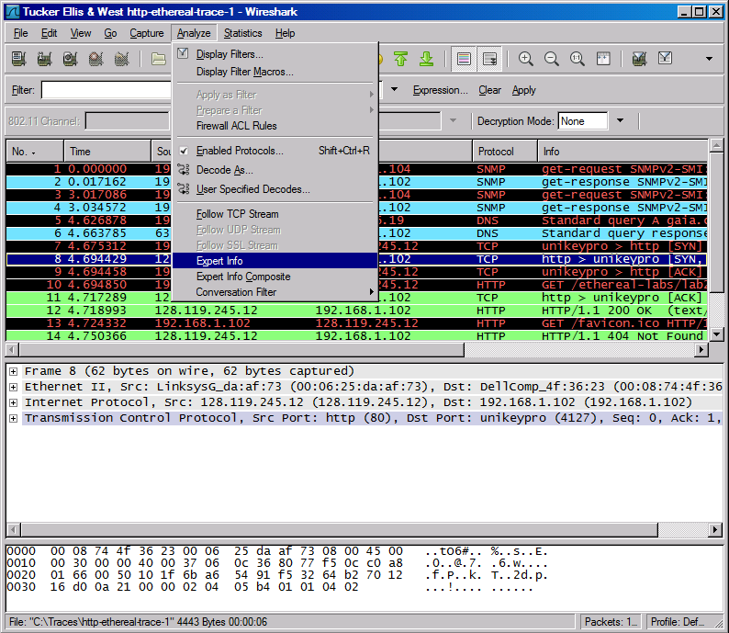
Expert Info

Slide 42
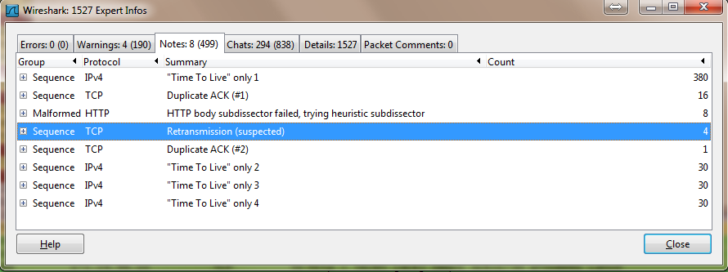
Expert Info

Slide 43
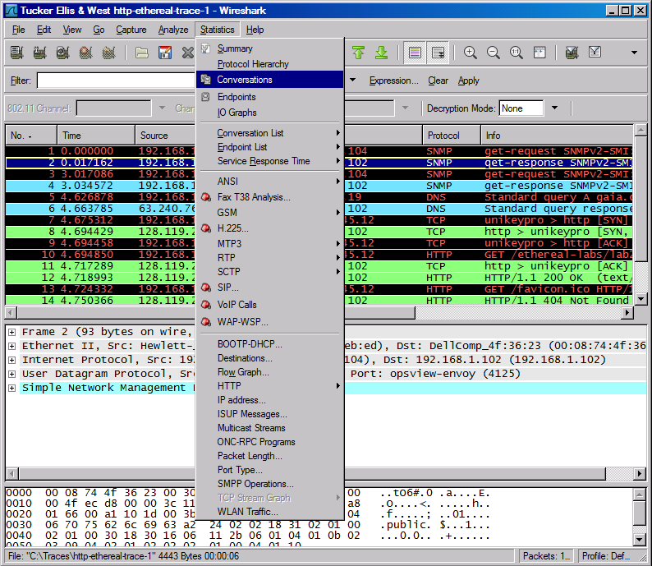
Conversations

Slide 44
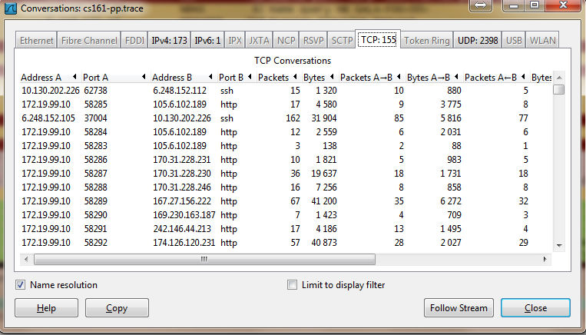
Conversations

Slide 45
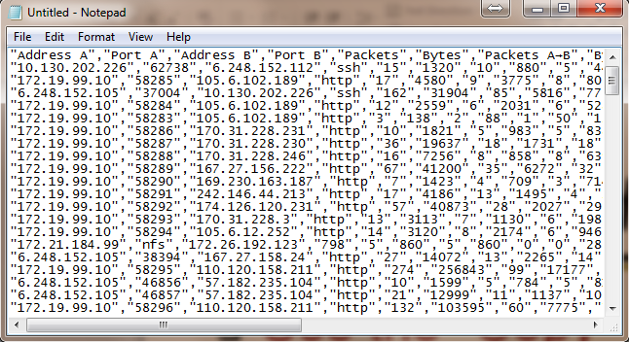
Use the “Copy” button to copy all text into clipboard
Then, you can analyze this text file to get what statistics you want

Slide 46
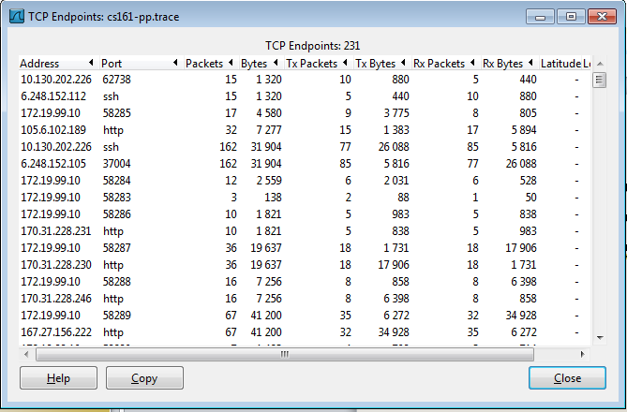
Find EndPoint Statistics
Menu “statistics” 🡪 “endpoint list” 🡪 “TCP”
You can sort by field
“Tx” : transmit “Rx” : receive

Slide 47
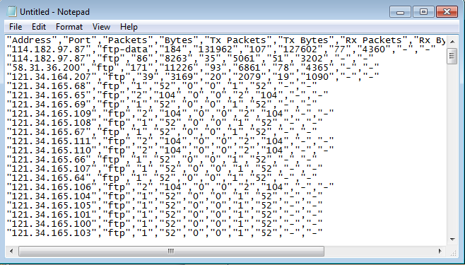
Find EndPoint Statistics
Use the “Copy” button to copy all text into clipboard
Then, you can analyze this text file to get what statistics you want

Slide 48
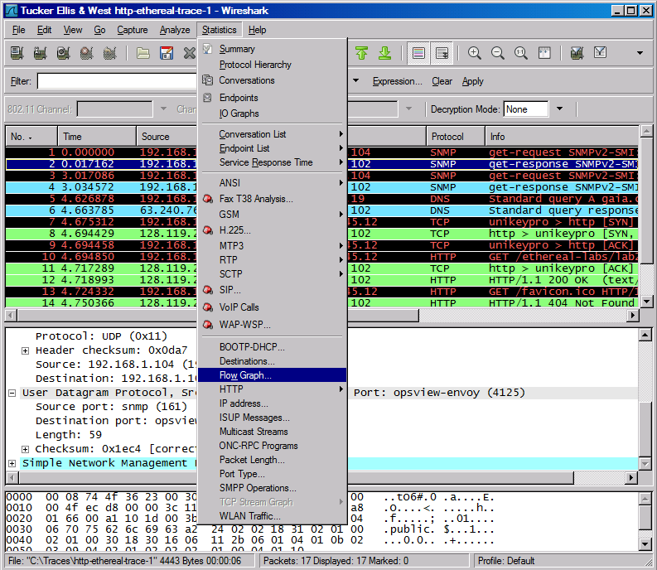
Flow Graphs

Slide 49
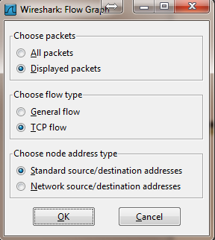
Flow Graphs
The “displayed packet” option could let you only
Show the flow of packets shown up
for example, only display http traffic, then show
The flow to analyze

Slide 50
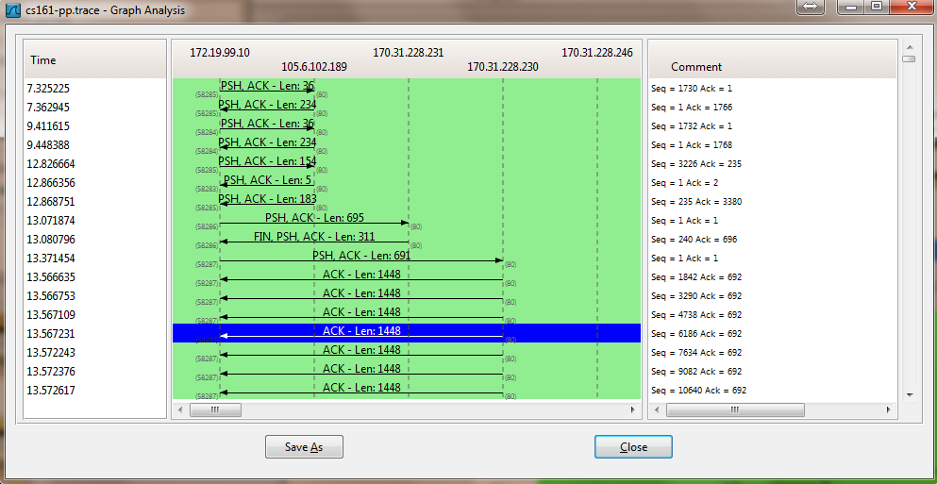
Flow Graphs

Slide 51
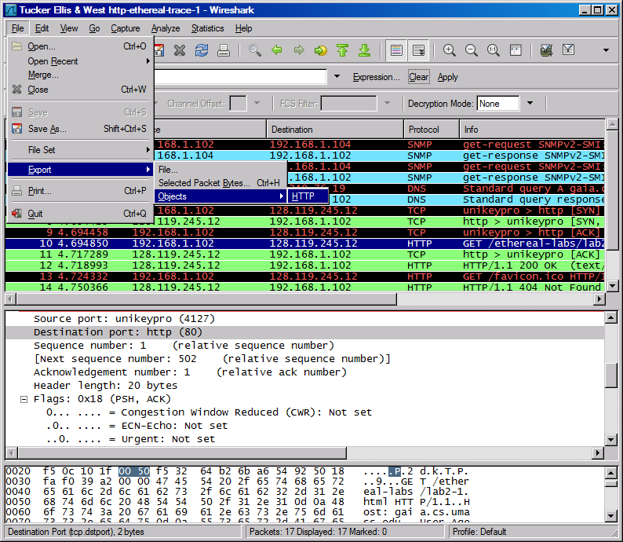
Export HTTP

Slide 52
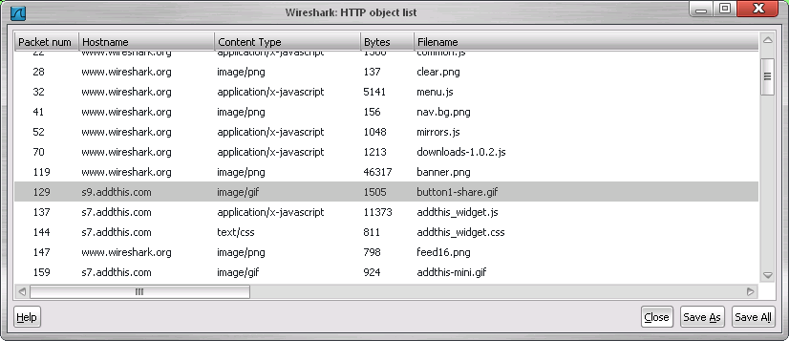
Export HTTP Objects

Slide 53
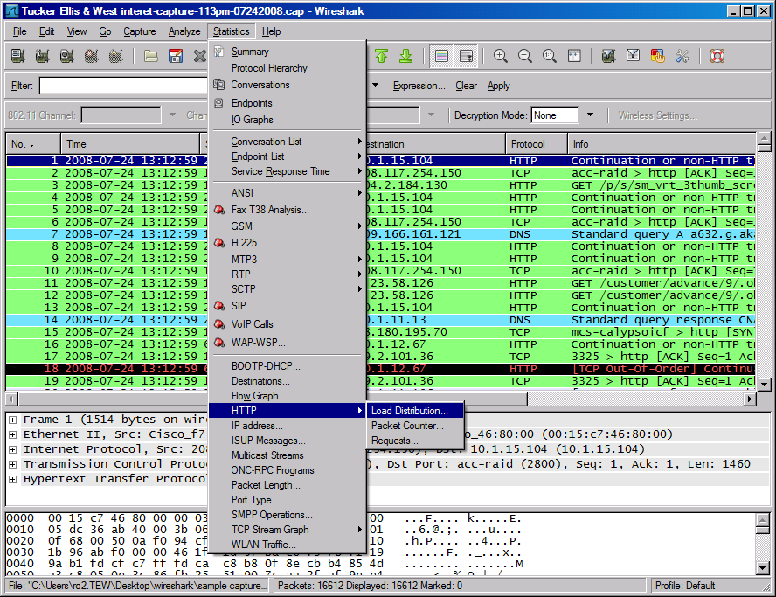
HTTP Analysis

Slide 54
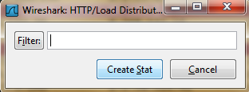
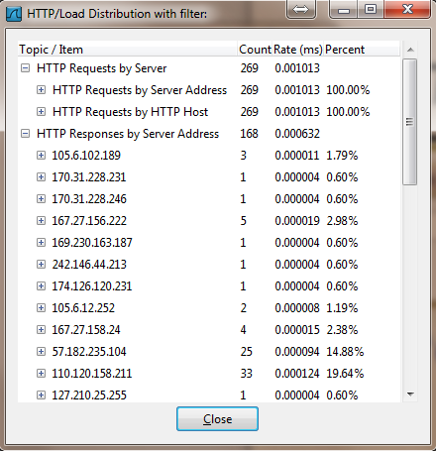
HTTP Analysis – Load Distribution
Click “Create Stat” button
You can add “filter” to only
Show selected traffic

Slide 55
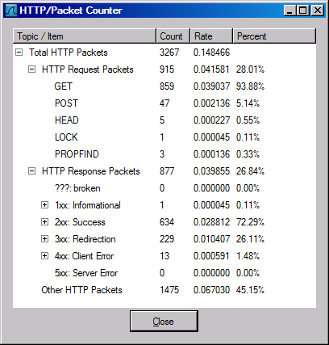
HTTP Analysis – Packet Counter

Slide 56
Improving WireShark Performance
Don’t use capture filters
Increase your read buffer size
Don’t update the screen dynamically
Get a faster computer
Use a TAP
Don’t resolve names

Slide 57
On-line Wireshark Trace Files
Public available .pcap files:
http://www.netresec.com/?page=PcapFiles
http://www.tp.org/jay/nwanalysis/traces/Lab%20Trace%20Files/
Wiki Sample capture
https://wiki.wireshark.org/SampleCaptures

Slide 58
Example Trace File and Questions
Network Forensic Puzzle Contests
http://forensicscontest.com/2010/02/03/puzzle-4-the-curious-mr-x
SharkFest'15 Packet Challenge
https://sharkfest.wireshark.org/assets/presentations15/packetchallenge.zip

Slide 59
Thank You

